Slide 1

POORNIMA INSTITUTE OF ENGINEERING &TECHNOLOGY JAIPUR
DEPARTMENT OF COMPUTER SCIENCE
INDUSTRIAL TRAINING PRESENTATION
ON
PYTHON BASIC
Prsented by - Ishu kumar Guided by-Department of CS
Reg no-piet20cs080
Year-2nd

Slide 2
On completion of my cource some basic detail of internship are : 1. mode of training online 2. certificate provided by coursera 3. technology area python basic 4. title of certification python 5. date of complatation 29/8/2021 6. hours / week 45+ / 4

Slide 3
coursera In 2012, coursera founder Koller built a software for a living virtual classroom Coursera is a global online learning platform that offers anyone, anywhere, access to online courses and degrees from leading universities and companies.

Slide 4
Introduction of Python
Python is developed by Guido van Rossum. Guido van Rossum started implementing Python in 1989. Python is a very simple programming language so even if you are new to programming, you can learn python without facing any issues.

Slide 5
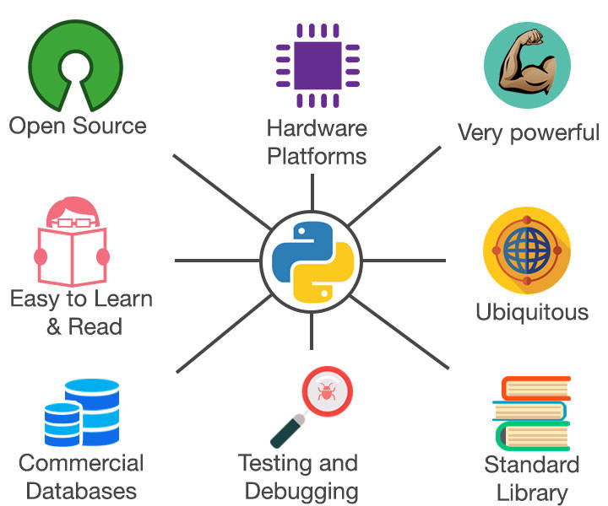
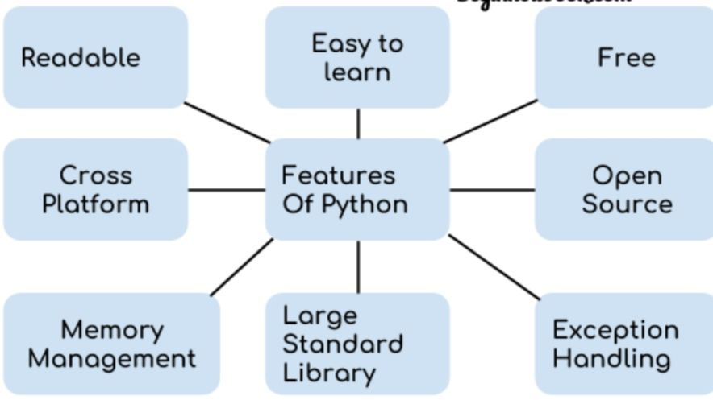
Features of Python programming language

Slide 6
Python Applications
Web Development. Python can be used to make web-applications at a rapid rate. ...
Game Development. Python is also used in the development of interactive games
Machine Learning and Artificial Intelligence.
Web Scraping Applications.
Business Applications

Slide 7
Who uses phython
Google (YouTube) Nasa Ibm Instagram Dropbox(providing cloud) Mozilla

Slide 8
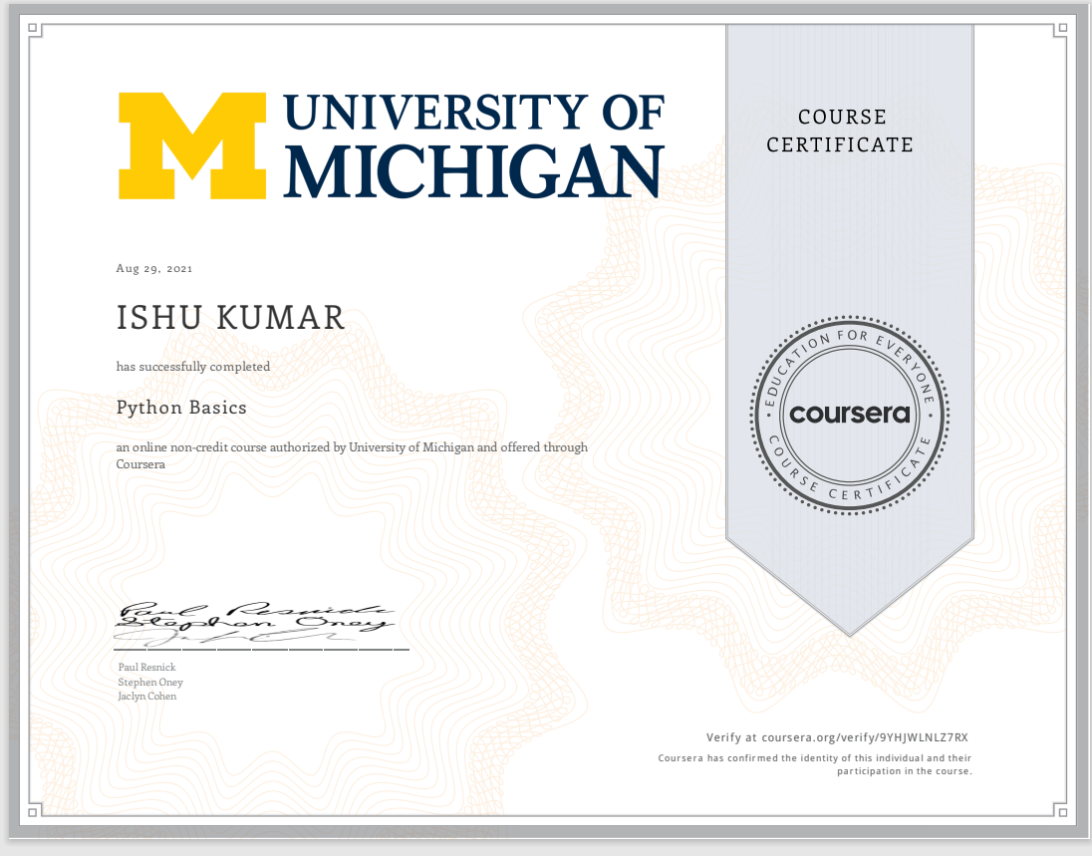
Certificate awarding by coursera

Slide 9
THANK YOU!

